Slide 1
PROGRAMMAZIONE WEB
CORSO ENAIP 2022

Slide 2

Agenda
1
Il Web
2
Basi di JavaScript
3
ASP.NET
4
Web Services
5
Test di fine modulo

Slide 3

Il Web
Internet e WWW
Funzionamento
Tecnologie coinvolte
Architettura client-server
Principali protocolli
HTTP
Richieste e risposte
Status code
Struttura pagine web
Basi di HTML, CSS

Slide 4

Il Web
3 TECNOLOGIE
Convenzione di denominazione degli URL
Protocollo HTTP
Formato documento HTML
Il Web è una potente e diffusa piattaforma per l'elaborazione distribuita
www: World Wide Web
URL: Uniform Resource Locator
HTTP: Hypertext Transfer Protocol
HTML: Hypertext Markup Language
Notes:
The World Wide Web became popular because ordinary people can use it to do really useful things with minimal training. But behind the scenes, the Web is also a powerful platform for distributed computing.
The principles that make the Web usable by ordinary people also work when the “user” is an automated software agent.
The Web is based on three technologies:
the URL naming convention,
the HTTP protocol,
HTML document format.
For now, I want to focus on URL and HTTP, and use HTML solely as an example.

Slide 5


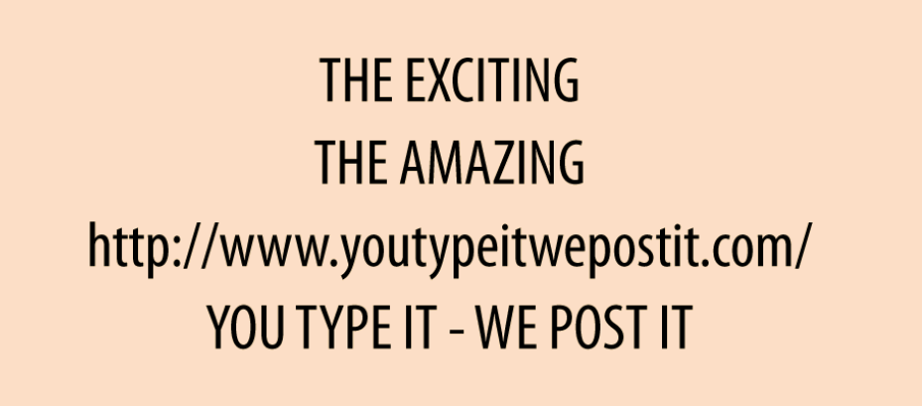
Il Web | Episode 1: Il poster
Un giorno Alice passeggiando vede un poster.
Alice è una giovane donna e ricorda benissimo la metà degli anni '90 e la reazione del pubblico quando gli URL hanno fatto la loro prima apparizione sui cartelloni pubblicitari.
Inizialmente, le persone prendevano in giro questi bizzarri codici dall'aspetto strano.
Non era chiaro cosa significasse «http://"o"youtypeitwepostit.com»
Ma 20 anni dopo, tutti sanno cosa fare con un URL. Basta digitarlo nella barra degli indirizzi del tuo browser web e premere Invio.
Ed è quello che fa Alice: prende il cellulare e inserisce http://www.youtypeitwepostit.com/ nella barra degli indirizzi del browser.
?
Cosa c'è all'altra estremità di quell'URL?
Notes:
One day Alice is walking around town and she sees a billboard.
Alice is old enough to remember the mid-1990s, so she recalls the public’s reaction when URLs started showing up on billboards. At first, people made fun of these weird-looking strings. It wasn’t clear what “http://” or “youtypeitwepostit.com” meant. But 20 years later, everyone knows what to do with a URL: you type it into the address bar of your web browser and hit Enter.
And that’s what Alice does: she pulls out her mobile phone and puts http://www.youtypeitwepostit.com/ in her browser’s address bar. The first episode of our story ends on a cliffhanger: what’s at the other end of that URL?

Slide 6
Il Web | Risorse (Resources)
Il browser web di Alice sta per inviare una richiesta HTTP a un server web, in particolare all'URL http://www.youtypeitwepostit.com/.
Un server Web può ospitare molti URL diversi e ogni URL concede l'accesso a un bit diverso di dati sul server.
Un URL è l'URL di qualcosa: un prodotto, un utente, la home page.
Il termine tecnico per l'oggetto denominato da un URL è
RISORSA (Resource)
L'URL http://www.youtypeitwepostit.com/ identifica una risorsa, probabilmente la home page del sito web pubblicizzato sul poster.
Ma non lo scopriremo quanto il browser web di Alice invierà la richiesta HTTP.
Notes:
Sorry for interrupting the story, but I need to introduce some basic terminology.
Alice’s web browser is about to send an HTTP request to a web server—specifically, to the URL http://www.youtypeitwepostit.com/. One web server may host many different URLs, and each URL grants access to a different bit of the data on the server.
We say that a URL is the URL of some thing: a product, a user, the home page. The technical term for the thing named by a URL is resource.
The URL http://www.youtypeitwepostit.com/ identifies a resource—probably the home page of the website advertised on the billboard. But you won’t know for sure until we resume the story and Alice’s web browser sends the HTTP request.

Slide 7

Il Web | Rappresentazioni
Client
(Browser WEB)
Richiesta HTTP
Risorsa
Risposta server
Documento
=
RAPRESENTAZIONE DELLA RISORSA
Ogni URL identifica una risorsa. Quando un client effettua una richiesta HTTP a un URL, ottiene una rappresentazione della risorsa sottostante.
Il client non vede mai una risorsa direttamente
Notes:
When a web browser sends an HTTP request for a resource, the server sends a document in response (usually an HTML document, but sometimes a binary image or something else).
Whatever document the server sends, we call that document a representation of the resource.
So each URL identifies a resource. When a client makes an HTTP request to a URL, it gets a representation of the underlying resource.
The client never sees a resource directly.

Slide 8
Il Web | Principio di indirizzabilità
Un URL identifica una e una sola risorsa.Se un sito Web contiene due elementi concettualmente diversi, ci aspettiamo che il sito li tratti come due risorse con URL diversi.Ci sentiamo frustrati quando un sito web viola questa regola.
PRINCIPIO DI INDIRIZZABLITÀ
=
Ogni risorsa dovrebbe avere il proprio URL
Se qualcosa è importante per la tua applicazione, dovrebbe avere un nome univoco, un URL, in modo che tu e i tuoi utenti possiate farvi riferimento senza ambiguità.
Notes:
A URL identifies one and only one resource.
If a website has two conceptually different things on it, we expect the site to treat them as two resources with different URLs.
We get frustrated when a website violates this rule.
The principle of addressability just says that every resource should have its own URL. If something is important to your application, it should have a unique name, a URL, so that you and your users can refer to it unambiguously.

Slide 9
Il Web | Episode 2: Home Page
Invia una richiesta HTTP su Internet al server web all'indirizzo http://www.youtypeitwepostit.com/
Alice inserisce l’URL che legge sul cartellone pubblicitario nella barra degli indirizzi del suo browser.
Notes:
Back to our story.
When Alice enters the URL from the billboard into her browser’s address bar, it sends an HTTP request over the Internet to the web server at http://www.youtypeitwepostit.com/:
GET / HTTP/1.1
Host: www.youtypeitwepostit.com

Slide 10
Episode 2: The Home Page
The web server handles this request (neither Alice nor her web browser need to know how) and sends a response:
HTTP/1.1 200 OK
Content-type: text/html
<!DOCTYPE html>
<html>
<head>
<title>Home</title>
</head>
<body>
<div>
<h1>You type it, we post it!</h1>
<p>Exciting! Amazing!</p>
<p class="links">
<a href="/messages">Get started</a>
<a href="/about">About this site</a>
</p>
</div>
</body>
</html>
The 200 at the beginning of the response is a status code, also called a response code. It’s a quick way for the server to tell the client approximately what happened to the client’s request. 200 (OK) means that the request was fulfilled with no problems.

Slide 11
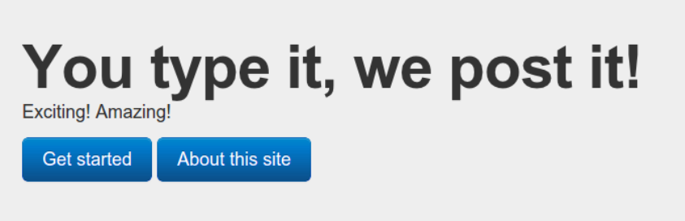
Episode 2: The Home Page
Alice’s web browser decodes the response as an HTML document and displays it graphically

Slide 12
Families of Status Codes
1xx: Informational These response codes are used only in negotiations between an HTTP client and server.
2xx: Successful Whatever state transition the client asked for has happened.
3xx: Redirection The state transition the client asked for has not happened. But if the client is willing to make a slightly different HTTP request, that request should do what the client is asking for.
4xx: Client Error The state transition the client has asked for has not happened, due to a problem with the HTTP request. The request was malformed, incoherent, self-contradictory, or one that the server cannot accept.
5xx: Server Error The state transition the client has asked for has not happened, due to a problem on the server side. There’s probably nothing the client can do but wait for the problem to be fixed.

Slide 13
Short Sessions
From Alice’s perspective, she’s “landed” on that page, which is her current “location” in cyberspace.
But as far as the server is concerned, Alice isn’t anywhere. The server has already forgotten about her.
HTTP sessions last for one request. The client sends a request, and the server responds. This means Alice could turn her phone off overnight, and when her browser restored the, she could click on one of the two links on this page and it would still work.
(Compare this to an SSH session, which is terminated if you turn your computer off.)
Alice could leave this web page open in her phone for six months, and when she finally clicks on a link, the web server would respond as if she’d only waited a few seconds. The web server isn’t sitting up late at night worrying about Alice. When she’s not making an HTTP request, the server doesn’t know Alice exists.
This principle is sometimes called statelessness.

Slide 14
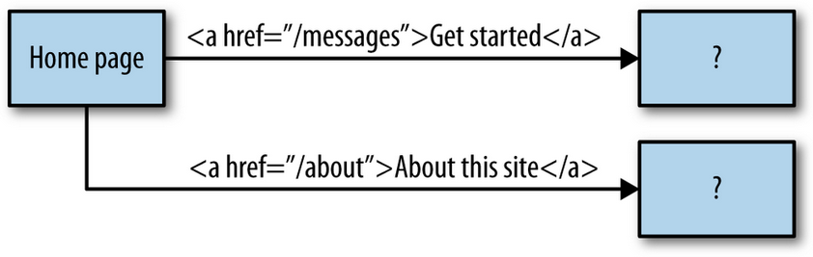
Self-Descricptive Messages
It’s clear from looking at the HTML that this site is more than just a home page.
The markup for the home page contains two links:
/about (i.e., to http://www.youtypeitwepostit.com/about)
/messages (i.e., http://www.youtypeitwepostit.com/messages).
At first Alice only knew one URL—the URL to the home page—but now she knows three. The server is slowly revealing its structure to her.
What’s on the other end of the /messages and /about links? The only way to be sure is to follow them and find out.

Slide 15
Episode 3: The Link
Alice clicks the link that says “Get started.” Of course, whenever you click a link in your web browser, you’re telling your web browser to make an HTTP request.
The code for the link Alice clicked on looks like this:
So her browser makes this HTTP request to the same server as before:
That GET in the request is an HTTP method, also known as an HTTP verb.
The HTTP method is the client’s way of telling the server what it wants to do to a resource.
“GET” is the most common HTTP method. It means “give me a representation of this resource.” For a web browser, GET is the default.
<a href="/messages">Get started</a>
GET /messages HTTP/1.1 Host: www.youtypeitwepostit.com

Slide 16
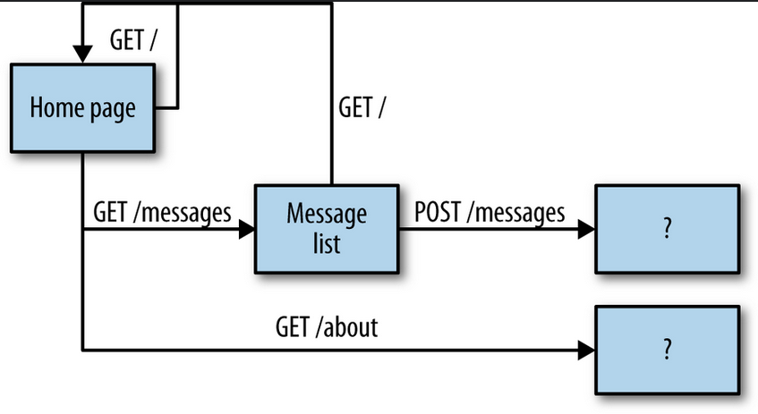
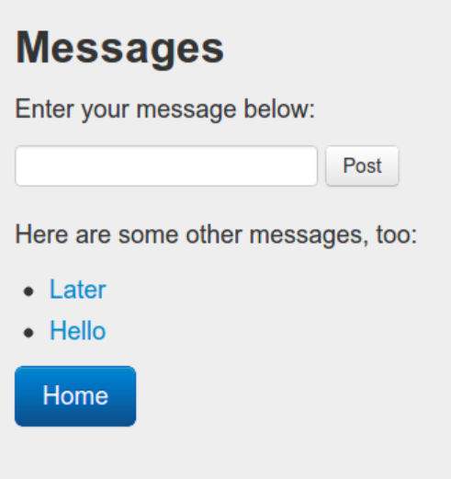
Episode 3: The Link
The server handles this particular GET request by sending a representation of /messages:
HTTP/1.1 200 OK
Content-type: text/html
... <!DOCTYPE html>
<html>
<head>
<title>Messages</title>
</head>
<body>
<div>
<h1>Messages</h1>
<p> Enter your message below: </p>
<form action="http://youtypeitwepostit.com/messages" method="post">
<input type="text" name="message" value="" required="true"
maxlength="6"/>
<input type="submit" value="Post" />
</form>
<div>
<p>
Here are some other messages, too:
</p>
<ul>
<li><a href="/messages/32740753167308867">Later</a></li>
<li><a href="/messages/7534227794967592">Hello</a></li>
</ul>
</div>
<p class="links">
<a href="http://youtypeitwepostit.com/">Home</a>
</p>
</div>
</body>
</html>
The server handles this particular GET request by sending a representation of /messages:

Slide 17
Standardized Methods
Both of Alice’s HTTP requests used GET as their HTTP method. But there’s a bit of HTML in the latest representation that will trigger an HTTP POST request if Alice clicks the Post button:
The HTTP standard (RFC 2616) defines eight methods a client can apply to a resource. In this book, I’ll focus on five of them: GET, HEAD, POST, PUT, and DELETE. Right now the important thing to keep in mind is that there are a small number of standard methods.
<form action="http://youtypeitwepostit.com/messages" method="post">
<input type="text" name="message" value="" required="true" maxlength="6"/>
<input type="submit" />
</form>
https://datatracker.ietf.org/doc/html/rfc2616/

Slide 18
Episodes 4: the Forme and the Redirect
Episode 4: The Form and the Redirect
<form action="http://youtypeitwepostit.com/messages" method="post">
<input type="text" name="message" value="" required="true" maxlength="6"/>
<input type="submit" />
</form>
https://datatracker.ietf.org/doc/html/rfc2616/

Slide 19
IL WEB
URLs identify resources. A client makes HTTP requests to those URLs. A server sends representations in response, and over time the client builds up a picture of the resource state, as seen through the representations. Eventually the client makes that fateful PUT or POST or PATCH request, sending a representation back to the server and modifying resource state.

